Slide 1
JavaScript & XHTML:
The DOM
INFO432
Advanced technologies of WEB

Slide 2
JavaScript environment
To make static web pages dynamic → JavaScript
How → access and manipulate the content
  Ex: add a tag, delete one, modify the content, the attribute, the style of a tag,…
Problem → How to access the tags of a web page?
Solution: The DOM: Document Object Model

Slide 3
DOM
DOM = interface between HTML-XHTML-XML and application programs
Bases on the treelike structure of all web pages
JavaScript supports the DOM.
HTML elements are represented as objects and element attributes are represented as properties
  Ex: <input type = "text" name = "address">
  represented as an object with two properties, type and name, with the values "text" and "address"
Notes:
This slide is explaining the DOM (Document Object Model) in web development. Let me break it down for you step by step:
DOM definition
The DOM is the interface between documents written in HTML, XHTML, or XML and application programs (like JavaScript).
It allows programs to read and manipulate the structure, style, and content of a webpage.
Tree-like structure
A web page is represented as a tree structure (hierarchy of nodes).
Example:
The <html> element is the root.
Inside it, you might have <head> and <body>.
Inside <body>, you can have <div>, <p>, <input>, etc.
Each element is like a “node” in a tree.
JavaScript and the DOM
JavaScript can access and manipulate the DOM.
Example: you can change text, styles, or attributes dynamically using JS code.
HTML elements as objects
In the DOM, each HTML element is treated as an object.
The attributes of an element are represented as properties of that object.

Slide 4
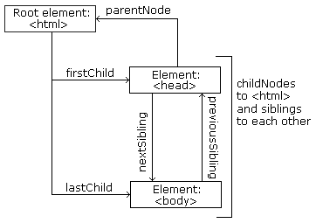
DOM

Slide 5
Document Tree Structure
document
document.body
5

Slide 6
Access elements in HTML
Several methods
  getElementById() → returns a reference on the object
  getElementsByTagName() → returns an array of elements having this tag name.
  getElementsByName() → returns an array of elements having this name.
  document.getElementsByClassName(className)→ returns an array of elements having the class className
Notes:
querySelector(selector)
Returns the first element that matches a given CSS selector.
Very flexible: you can search by id, class, tag, or even complex CSS selectors.

Slide 7
Access elements in HTML
Using object collections
document.head → the <head> element.
document.title → the title of the document.
document.body → the <body> element of the document.
document.documentElement → the root <html>
element.document.embeds → all <embed> elements.
document.forms → all <form> elements.
document.images → all <img> elements.
document.links → all <a> elements with an href attribute.
document.scripts → all <script> elements.
document.anchors → all <a> elements with a name attribute.
These return HTMLCollection or NodeList (array-like objects, not true arrays, but can be accessed with indices [0], [1]…)

Slide 8
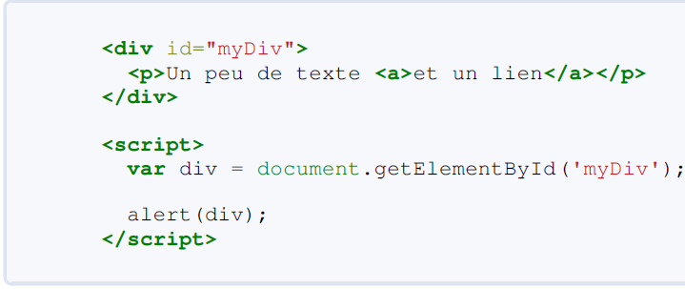
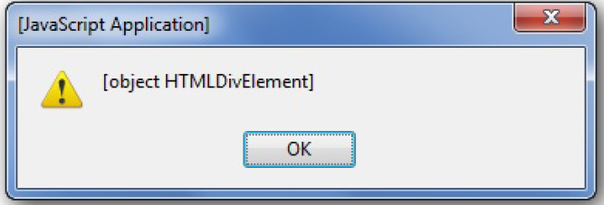
Access elements in HTML
getElementById()

Slide 9
Access elements in HTML
getElementById()
<form action = "">
  <input type = "button" id = "pushMe" />
</form>
document.getElementById("pushMe")

Slide 10
Access elements in HTML
<form id = "topGroup">
  <input type="checkbox" name="toppings" value="olives" />
  ...
  <input type="checkbox“ name="toppings" value="tomatoes" />
</form>
...
var numChecked = 0;
var dom = document.getElementById("topGroup");
for(index = 0; index < dom.toppings.length; index++)
  if (dom.toppings[index].checked]
    numChecked++;

Slide 11
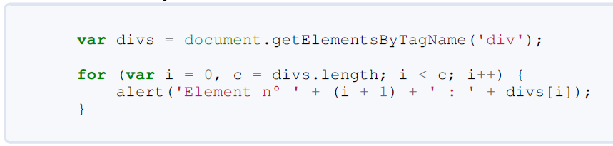
Access elements in HTML
getElementsByTagName()

Slide 12
Access elements in HTML
getElementsByName()
  Same as getElementsByTagName but here retrieves only tags having the name given as parameter
  Especially used for forms access

Slide 13
HTML DOM Node access
X.innerHTML : html text in X
X.nodeName : node name of X
X.nodeType : node type of X
X.parentNode : parent node
X.childNodes: array of X children nodes
X.attributes : array of X attributes
X.firstChild : X’ first child node
X.lastChild : X’ last child node
X.nextSibling : X next sibling node
X.previousSibling : X previous sibling node

Slide 14
innerHTML vs outerHTML
a
outerHTML
<div> Hello <b>World</b> </div>
innerHTML

Slide 15
Edit Attributes of Elements
X.getAttribute(“Attribute name”) : Get an attribute value
X.setAttribute(“Attribute name”,”Attribute value”) : Set attribute value
X.removeAttribute(“Attribute name”) : Remove attribute

Slide 16
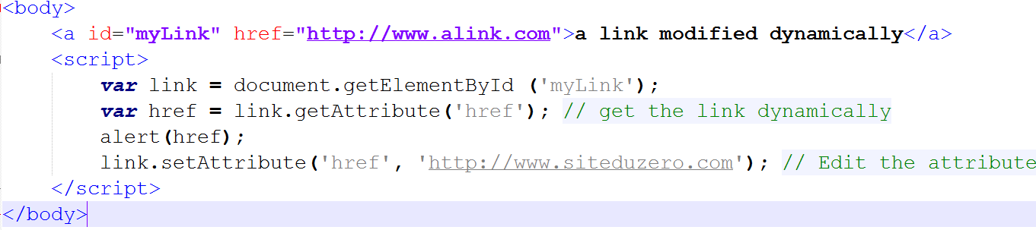
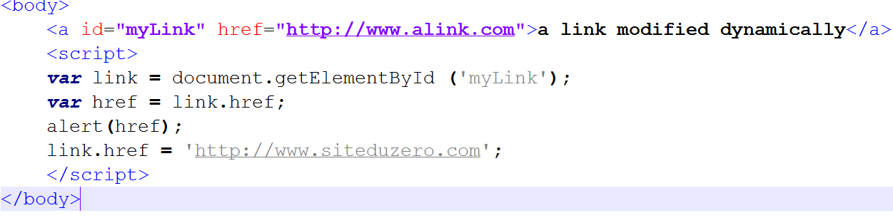
Edit Attributes of Elements

Slide 17
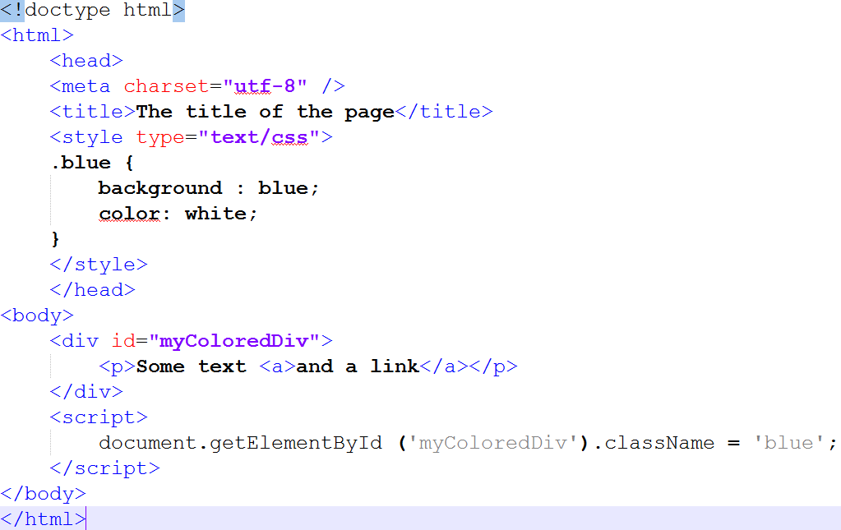
Edit class Attribute of style

Slide 18

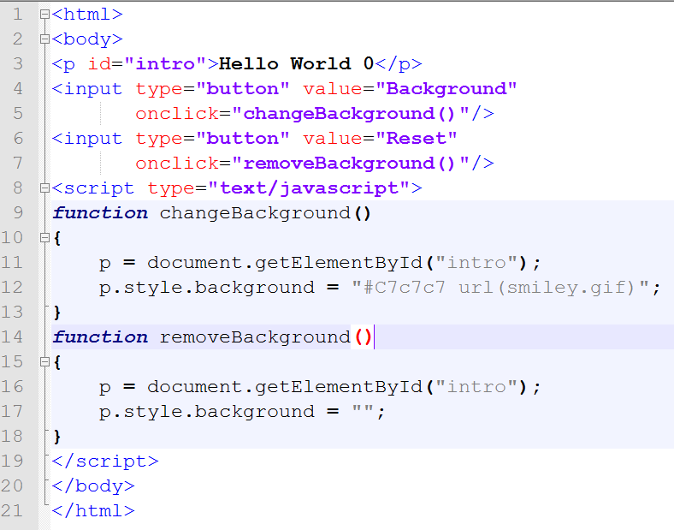
Edit style properties

Slide 19
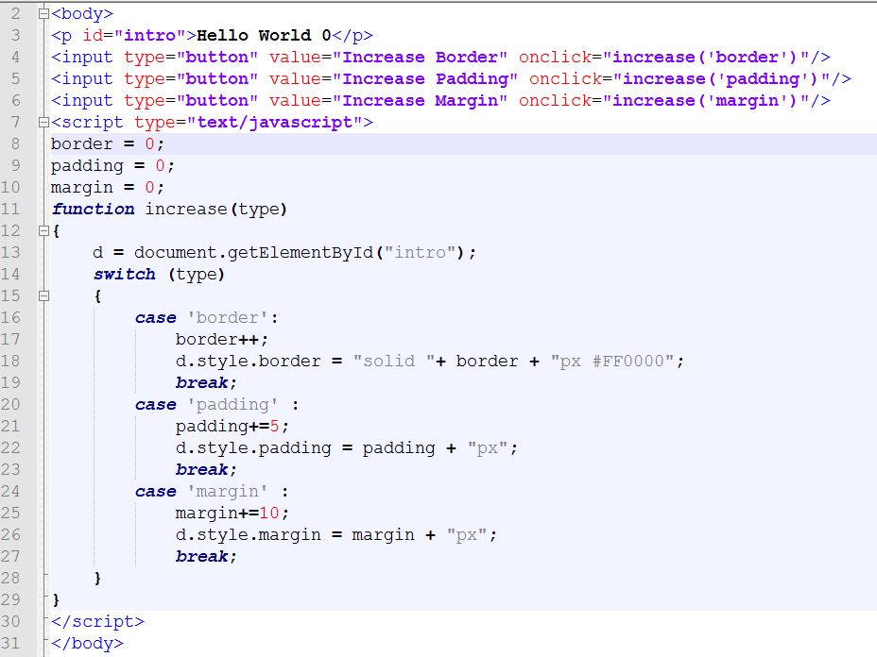
Ví dụ

Slide 20
Edit style properties
DOM Node properties

Slide 21
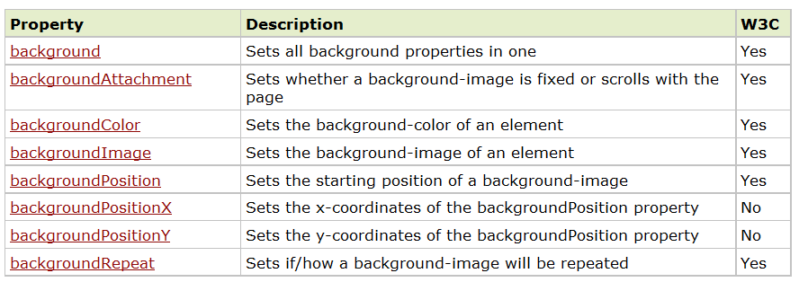
Edit style properties
Style background

Slide 22
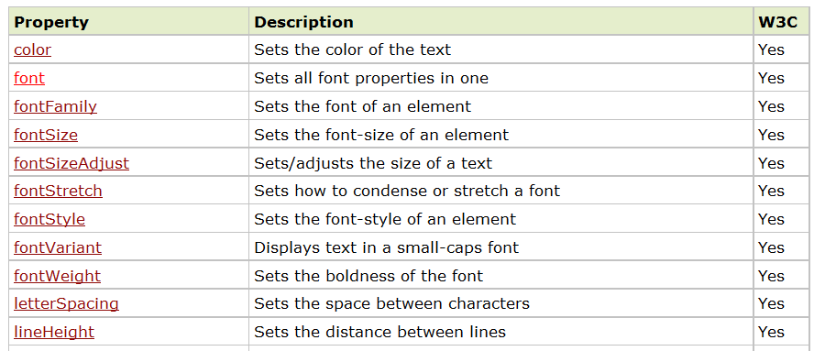
Edit style properties
Style font

Slide 23
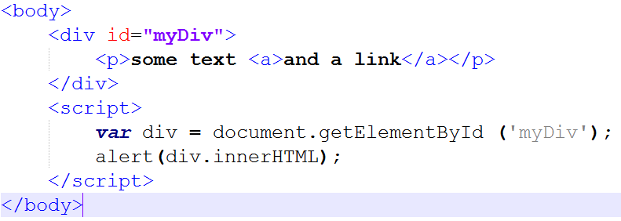
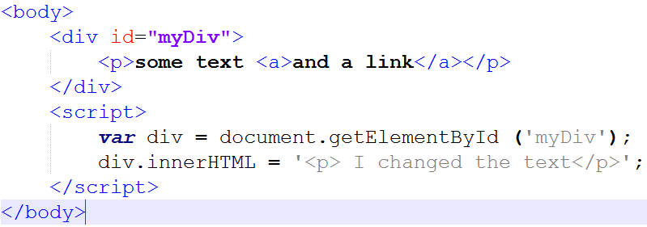
Edit the content of a tag

Slide 24
Content of Tag
innerHTMl and innerText (TextContent)
<body>
<div id="myDiv">
<p>Simple text <a href="#">and a link</a></p>
</div>
<script>
var div = document.getElementById('myDiv');
// innerHTML → returns content WITH tags
alert(div.innerHTML); //<p>Simple text <a href="#">and a link</a></p>
// innerText → returns only the text (no tags)
alert(div.innerText); //Simple text and a link
</script>
</body>
Notes:
innerHTML → Returns HTML markup (tags + text).
innerText → Returns only the visible text (takes CSS into account).
textContent → Returns all text, regardless of CSS (hidden text included).

Slide 25
child, sibling, parent
25
Notes:
25

Slide 26
child, sibling, parent
26

Slide 27
child, sibling, parent
27

Slide 28
child, sibling, parent
28

Slide 29
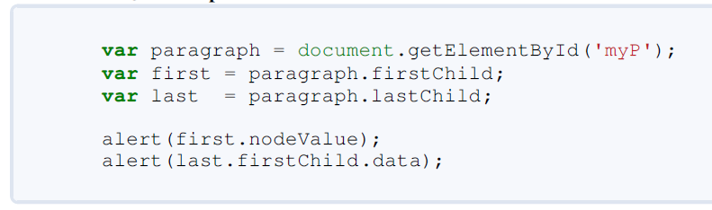
First child & last child + nodeValue & data
Notes:
Key Difference
.nodeValue → general property for all node types (elements, attributes, text, comments).
.data → exists only for text nodes, comment nodes, and other CharacterData types.
👉 So:
Use .nodeValue when dealing with generic nodes.
Use .data when you specifically know it’s a text or comment node.

Slide 30
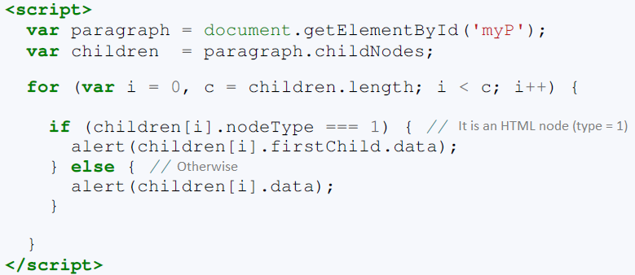
childNodes

Slide 31
Create tags
Create a tag
  var newLink = document.createElement('a');
Assign values to attributes
  newLink.id = ‘myLink';
  newLink.href = 'http://www.myWebSite.com';
  newLink.title = ‘My own webpage !';
  newLink.setAttribute('tabindex', '10');

Slide 32
Add-remove tags(nodes)
X.appendChild ( Y) : add node Y into node X
X.removeChild ( Y ) : remove node Y out of node X
document.createTextNode(“Text”) : create a text node
X.cloneNode(true) → copy node with its children
  If false → without chaildren
X.replaceChild → replace a node by another
Notes:
🔹 X.appendChild(Y)
Adds node Y as the last child of node X.
Used to insert new elements or text into an existing element.
Example: add a new <p> to a <div>.
🔹 X.removeChild(Y)
Removes node Y from inside node X (its parent).
You must remove it from the element that currently contains it.
🔹 document.createTextNode("Text")
Creates a new text node containing the given text (not yet displayed).
You must attach it to an element (for example using appendChild).
🔹 X.cloneNode(true)
Creates a copy (clone) of node X.
If the argument is true → clones X and all its children (deep copy).
If false → clones only X itself (shallow copy, without children).
🔹 X.replaceChild(newNode, oldNode)
Replaces oldNode (a child of X) with newNode.
The old node is removed and the new one takes its place.
<!DOCTYPE html>
<html>
<body>
<div id="myDiv"></div>
<script>
// 1. Create a text node
var text = document.createTextNode("Hello, this is a text node!");
// 2. Get the parent element (div)
var div = document.getElementById("myDiv");
// 3. Append the text node to the div
div.appendChild(text);
</script>
</body>
</html>

Slide 33
Other methods
hasChildNodes() → to test if a node contains children
insertBefore()→ insert a node before another one
  X.insertBefore(p, q) → insert p before q in the node X
insertAfter() → same as insertBefore but here after

Slide 34
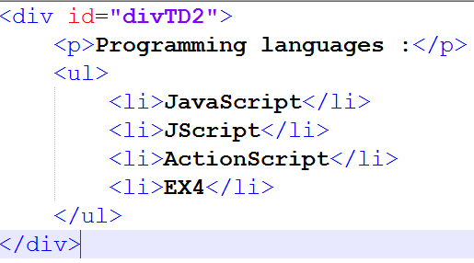
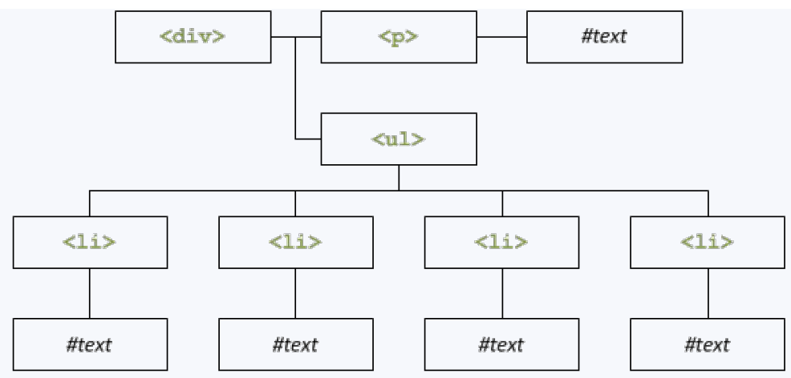
Exercise
Write the JavaScript code that creates the following web page

Slide 35
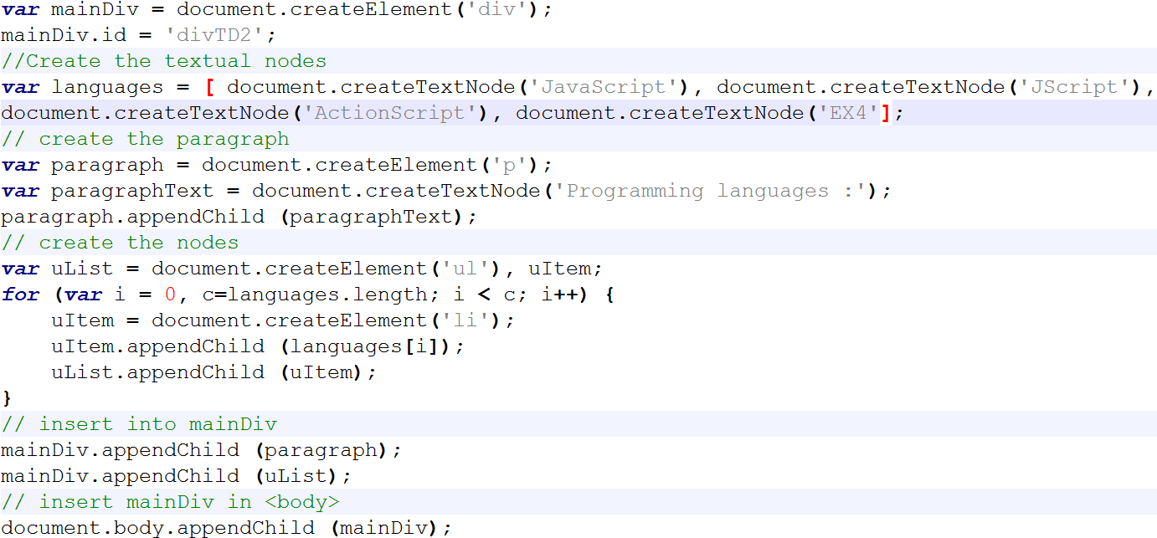
Exercise

Slide 36
Events

Slide 37
Events & Events Handling
When to manipulate content of a page → event happens on an element
  Ex: click on a button, mouse over an image, ….
How to do ?
  Associate an event handler to be executed to the tag for this specific event
The process of connecting an event handler to an event is called registration

Slide 38
DOM communicates to JavaScript with Events
Event types:
Mouse-related: mouse movement, button click, enter/leave element
Keyboard-related: down, up, press
Focus-related: focus in, focus out (blur)
Input field changed, Form submitted
Timer events
Miscellaneous:
  Content of an element has changed
  Page loaded/unloaded
  Image loaded
  Uncaught exception

Slide 39
Event handling
Creating an event handler: must specify 3 things:
What happened: the event of interest.
Where it happened: an element of interest.
What to do: JavaScript to invoke when the event occurs on the element.

Slide 40
Specifying the JavaScript of an Event
Option #1: in the HTML:
<div onclick="gotMouseClick('id42'); gotMouse=true;">...</div>
Option #2: from Javascript using the DOM:
element.onclick = mouseClick;
or
element.addEventListener("click", mouseClick);
Example of the powerful listener/emitter pattern
Notes:
Explanation:
The event handler is written directly inside the HTML tag.
When the user clicks the <div>, the browser executes the code in the onclick attribute.
Here, it calls the function gotMouseClick('id42') and sets the variable gotMouse to true.
Option #2
Assigns a function reference to the element’s onclick event.
You can only have one function assigned this way — if you assign another, it replaces the previous one.
OR
Adds an event listener without overwriting others.
You can attach multiple listeners to the same event.
Supports advanced options like event bubbling, capturing, and removal.

Slide 41
Event object
Event listener functions passed an Event object
Typically sub-classed MouseEvent, KeyboardEvent, etc.
Some Event properties:
type - The name of the event ('click', 'mouseDown', 'keyUp', …)
timeStamp - The time that the event was created
currentTarget - Element that listener was registered on
target - Element that dispatched the event
Notes:
when an event (like a click or key press) occurs, JavaScript automatically creates an Event object and passes it to your event handler function.
<button id="myButton">Click me!</button>
<script>
const button = document.getElementById("myButton");
button.addEventListener("click", function(event) {
console.log("Event type:", event.type);
console.log("Event timestamp:", event.timeStamp);
console.log("Event target:", event.target);
console.log("Event currentTarget:", event.currentTarget);
});
</script>
Event type: click
Event timestamp: 1489.234
Event target: <button id="myButton">Click me!</button>
Event currentTarget: <button id="myButton">Click me!</button>

Slide 42
MouseEvent and KeyboardEvent
Some MouseEvent properties (prototype inherits from Event)
button - mouse button that was pressed
pageX, pageY: mouse position relative to the top-left corner of document
screenX, screenY: mouse position in screen coordinates
Some KeyboardEvent properties (prototype inherits from Event)
  keyCode: identifier for the keyboard key that was pressed - Not necessarily an ASCII character! (deprecated)
  charCode: integer Unicode value corresponding to keypress, if there is one

Slide 43
Draggable Rectangle - HTML/CSS
<style type="text/css"> #div1 {
position: absolute;
}
</style>
...
<div id="div1" onmousedown="mouseDown(event);" onmousemove="mouseMove(event);" onmouseup="mouseUp(event);">Drag Me!</div>
Notes:
he <div> with id div1 is positioned absolutely, meaning you can control its position on the screen using CSS properties left and top.
The onmousedown, onmousemove, and onmouseup attributes attach event handlers that respond to mouse actions:
mousedown: when you press the mouse button on the div
mousemove: when you move the mouse
mouseup: when you release the mouse button

Slide 44
Draggable Rectangle - JavaScript
var isMouseDown = false; // Dragging? var prevX, prevY;
function mouseDown(event) { prevX = event.pageX; prevY = event.pageY; isMouseDown = true;
}
function mouseUp(event) { isMouseDown = false;
}
function mouseMove(event) { if (!isMouseDown) {
return;
}
var elem = document.getElementById("div1"); elem.style.left = (elem.offsetLeft +
(event.pageX - prevX)) + "px"; elem.style.top = (elem.offsetTop +
(event.pageY - prevY)) + "px";
prevX = event.pageX;
prevY = event.pageY;
}
Notes:
These are global variables used to manage dragging state and position.
🖱️ 3. mouseDown(event)
function mouseDown(event) {
prevX = event.pageX;
prevY = event.pageY;
isMouseDown = true;
}
Triggered when you press the mouse button.
It records the current mouse position (pageX, pageY).
Sets isMouseDown = true to indicate that dragging has started.
🖱️ 4. mouseUp(event)
function mouseUp(event) {
isMouseDown = false;
}
Triggered when you release the mouse button.
It ends the dragging by setting isMouseDown = false.
🖱️ 5. mouseMove(event)
function mouseMove(event) {
if (!isMouseDown) {
return; // Only move if the mouse button is held down
}
var elem = document.getElementById("div1");
elem.style.left = (elem.offsetLeft + (event.pageX - prevX)) + "px";
elem.style.top = (elem.offsetTop + (event.pageY - prevY)) + "px";
prevX = event.pageX;
prevY = event.pageY;
}
This function does the actual movement:
If the mouse isn’t pressed, it stops (return).
It gets the div (elem).
Calculates how much the mouse moved:
(event.pageX - prevX) = change in horizontal position
(event.pageY - prevY) = change in vertical position
Moves the div by adding these deltas to its current position (offsetLeft, offsetTop).
Updates prevX and prevY for the next move.

Slide 45
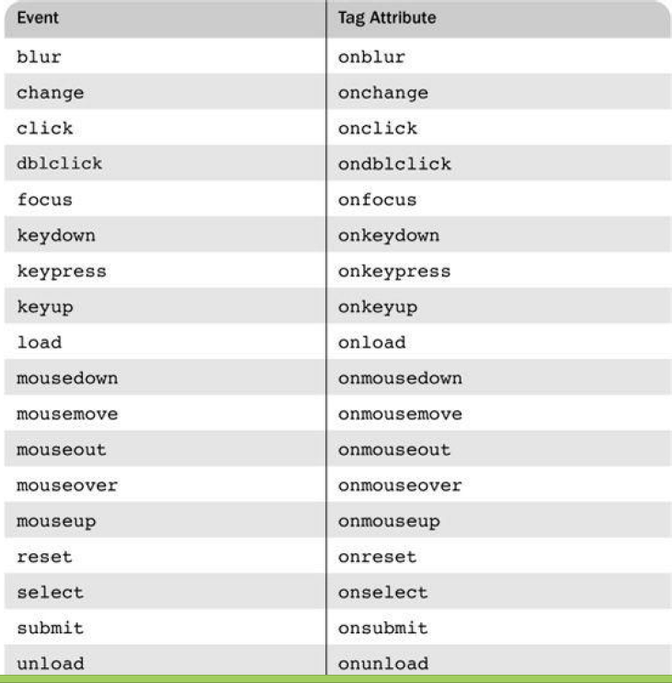

Slide 46
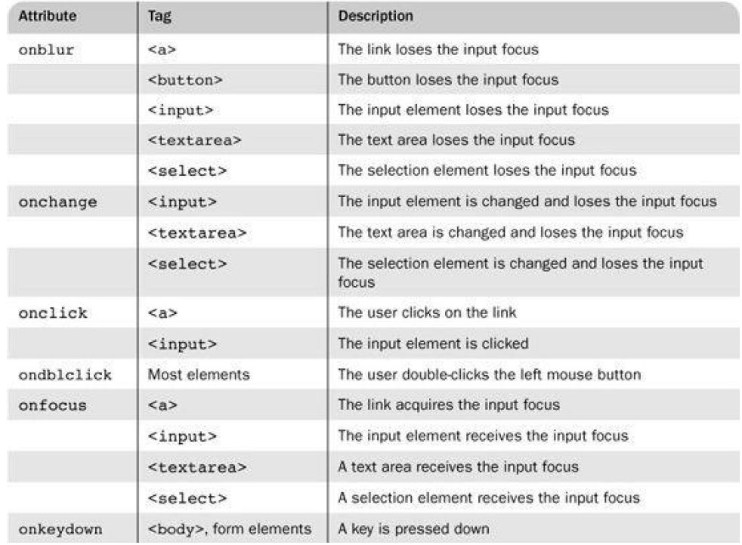
Notes:
The onblur event in JavaScript is triggered when an element loses focus — meaning the user was interacting with it (for example, typing in an input box) and then clicks or tabs away from it.

Slide 47
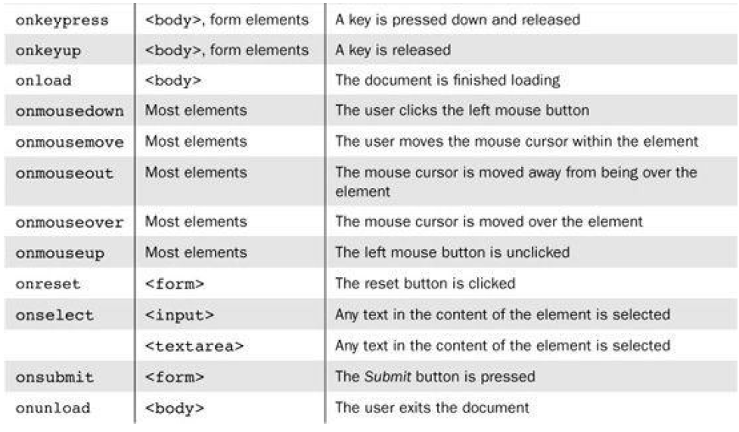

Slide 48
Registering an event
Assign the event handler script to an event tag attribute
onclick = "alert('Mouse click!');“
or
onclick = "myHandler();"
<a id=“mylink” href=“” onclick=“alert(‘you have clicked me’);”> click me</a>
<a id=“mylink” href=“” onclick=“LinkClick();”> click me</a> (or without parenthesis)
<a id=“mylink” href=“” onclick=“this.textContent=‘do not click me anymore’; return false;”> click me</a>
  Return false → to block the link
Document.getElementById(“myLink”).onclick = linkClick;
Notes:
What is Event Registration?
Event registration means telling the browser what code to run when a specific event happens on a specific element.
Example:
“When this link is clicked, run this JavaScript code.”
<a id="myLink" href="">Click me</a>
<script>
function linkClick() {
alert("You have clicked me!");
return false;
}
document.getElementById("myLink").onclick = linkClick;
</script>
Explanation:
document.getElementById("myLink") → gets the link element by its ID.
.onclick = linkClick; → assigns the function linkClick as the event handler.
When the link is clicked, the function runs.
Returning false from the function prevents the link’s default navigation.

Slide 49
Simple example
<head>
  <title> load.html </title>
  <meta charset = "utf-8" />
  <script type = "text/javascript" src = "load.js" > </script>
</head>
<body onload="load_greeting();">
…….
</body>
function load_greeting () {
alert("You are visiting my home page. You are welcomed");
}

Slide 50
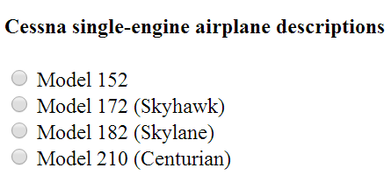
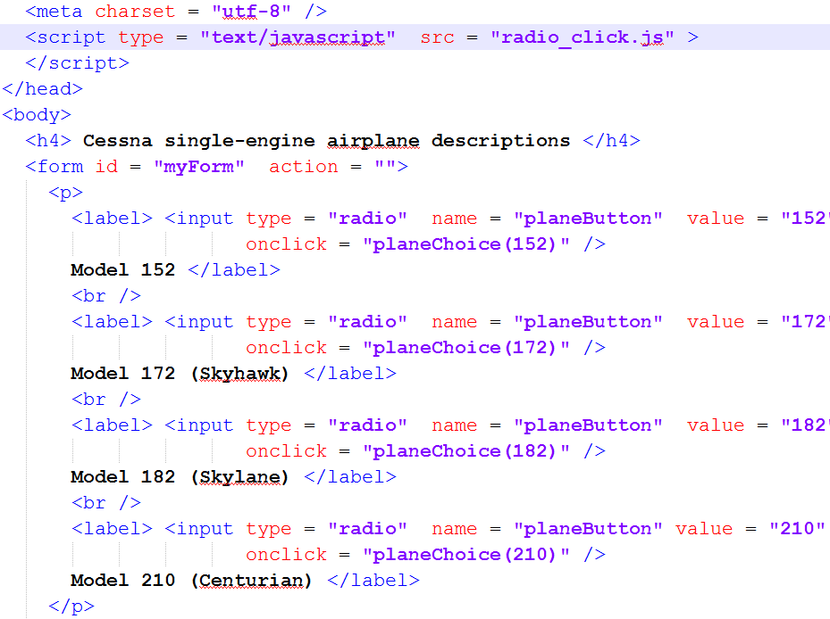
Handle inputs

Slide 51
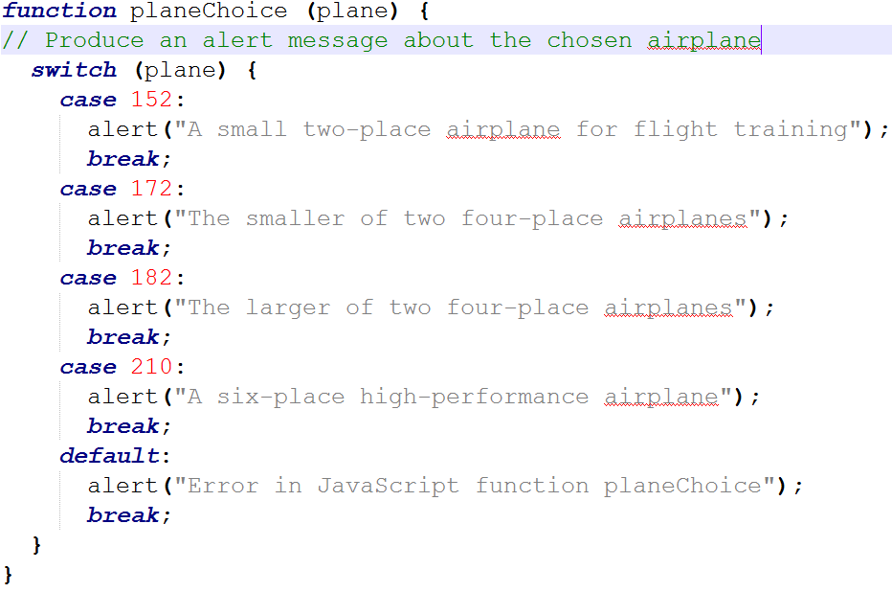
Handle inputs

Slide 52
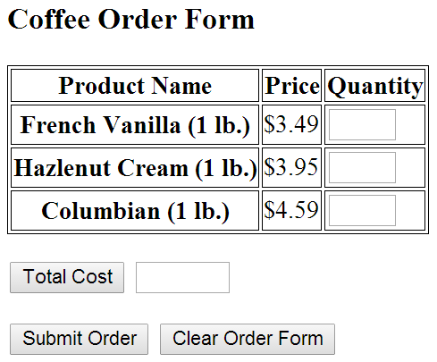
TextBox events

Slide 53
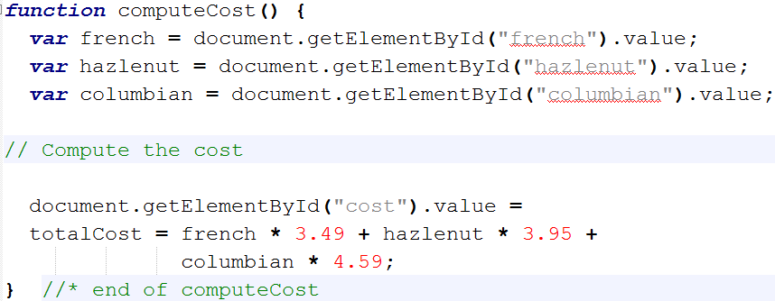
TextBox events

Slide 54
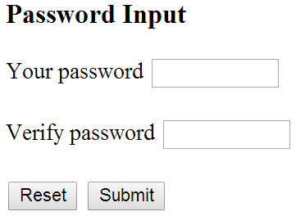
Validating forms
We want to check that the passwords match before sending them to the server

Slide 55
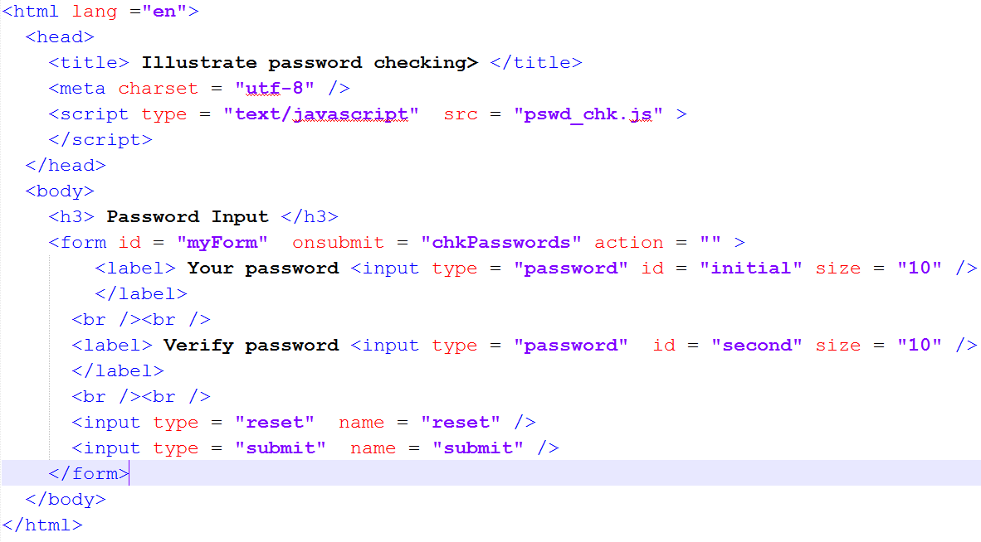
To validate a form
  put a handler on the onsubmit attribute of the form

Slide 56
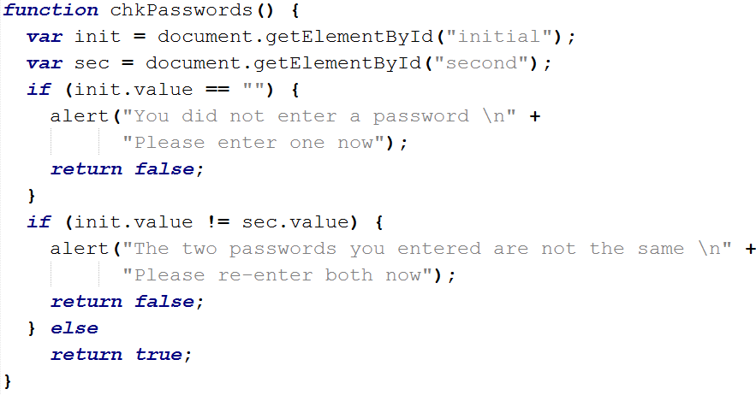
If not valid → return false
  Return false tells the browser to not to submit the form

Slide 57
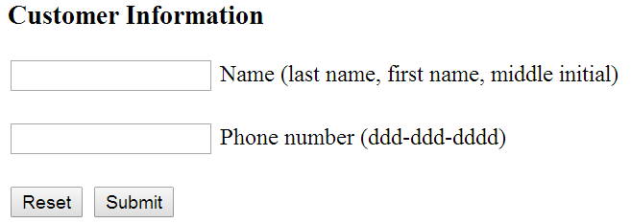
Validating forms
We want to check that the inputted data match the format

Slide 58
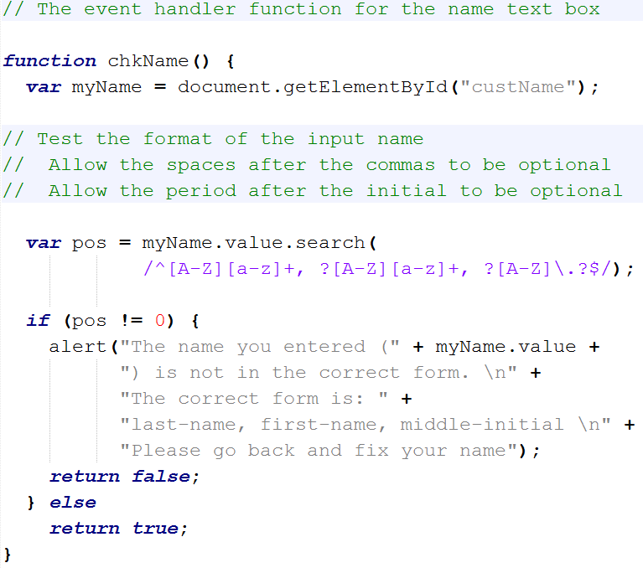

Slide 59
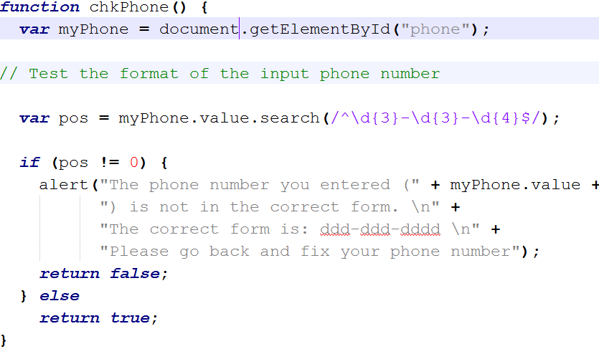

Slide 60
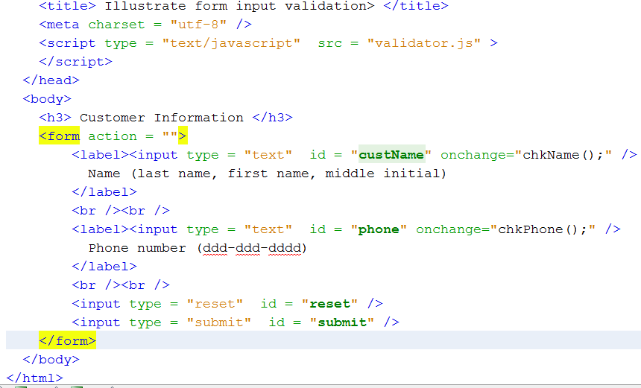

Slide 61
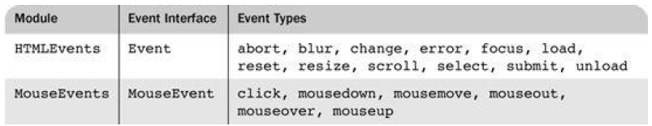
DOM2
Problem of assigning event handler by attribute
  No way to use parameters
DOM 2 is more sophisticated and powerful model
Has a module Events
Advantages:
  It is good to keep HTML and JavaScript separate
  The handler could be changed during use

Slide 62
How to register event handler?
X.addEventListener(eventType, handler, boolean)
X. removeEventListener(eventType, handler, boolean)
Event.currentTarget → a reference on the element generating the events

Slide 63
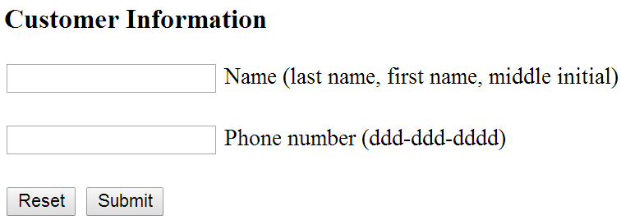
Form validator

Slide 64
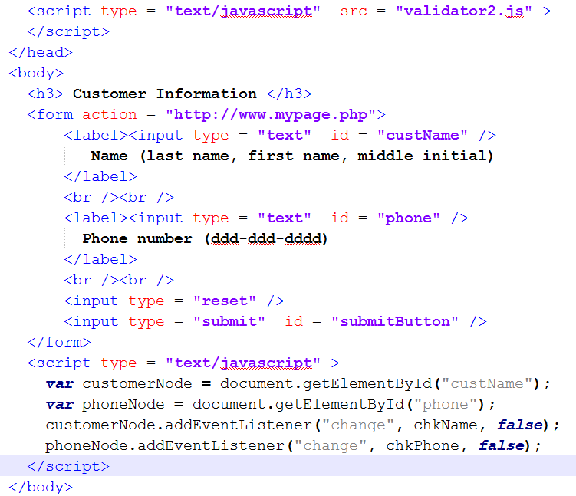
Form validator

Slide 65
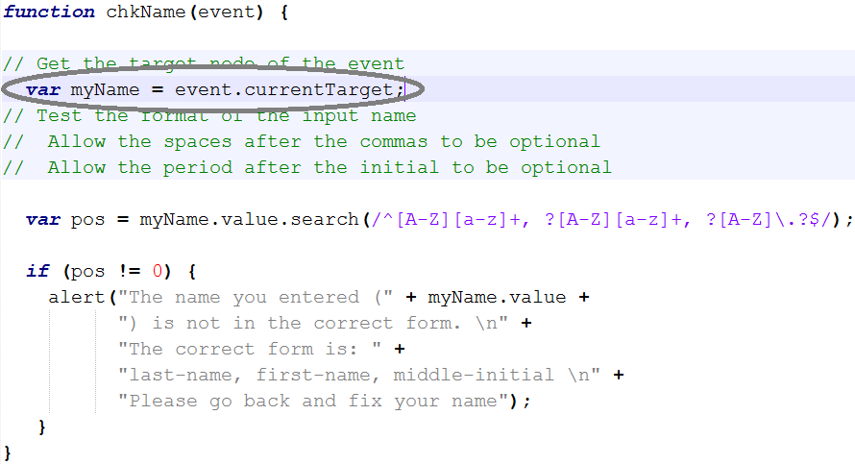
Form validator

